Slide 1


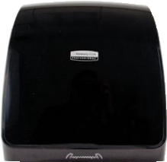
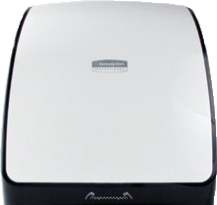
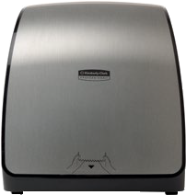
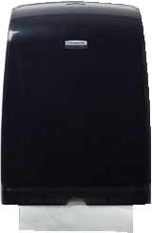
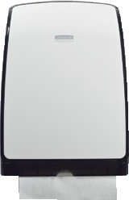
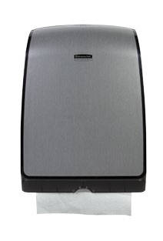
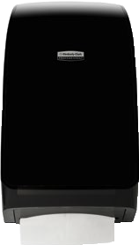
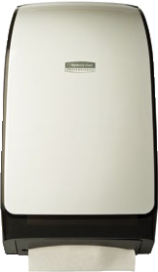
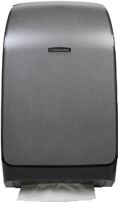
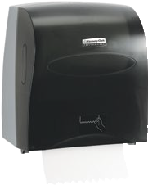
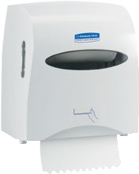
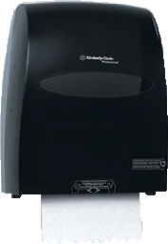
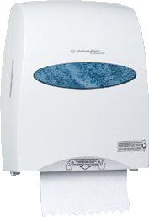
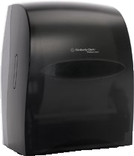
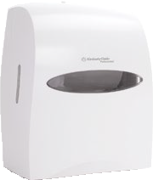
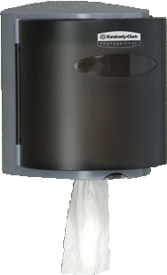

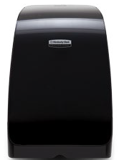
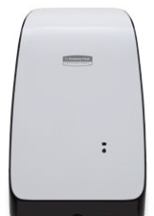
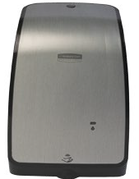
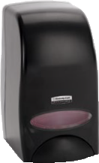
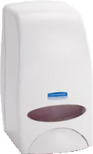
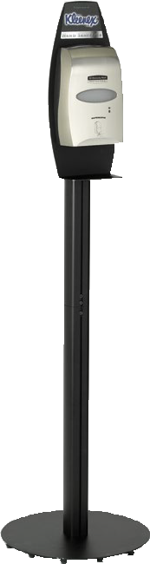
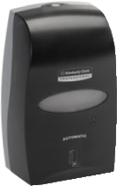
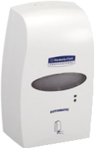


Office Products
Towel, Tissue and Skincare Dispenser Promotion April 1–December 31, 2015†
Towel Dispensing Systems (DROP SHIP ONLY UNLESS NOTED)
Mod* Slimroll* Hard Roll Towel Dispensers
Product # Mfr # Color
Mod* Slimfold* Folded Towel Dispensers
Mod* Scottfold* Folded Towel Dispensers
Product # Mfr # Color
36016 Black
36035 White
$3
Product # Mfr # Color 34828 Black
34830 White
$1
 | 39711 | Black | $6
 | 39640 | White | $6
 | 39712 | Faux Stainless | $15
$3
$1
Refill: 12388, 43753
36034
Faux Stainless
$20
Refill: 04442, 29575
39718
Faux Stainless
$5
Refill: 01960, 13253
Slimroll* Hard Roll Towel Dispensers
Product # Mfr # Color
Sanitouch Hard Roll Towel Dispensers
Product # Mfr # Color
Electronic Touchless Roll Towel Dispensers
Product # Mfr # Color
Roll Control Center-Pull Towel Dispenser
Product # Mfr # Color
10441 Smoke/Grey $3
09996 Smoke/Grey | $20
09995 White | $20
 | 09992 Smoke/Grey $20
 | 09993 White $20
09989 Smoke/Grey $7
Refill: 12388, 43753
10442 White
$3
Refill: 50606, 50500, 02000
Refill: 50606, 50500, 02000
Refill: 01032
Skin Care Dispensing Systems (DROP SHIP ONLY UNLESS NOTED)
Electronic Cassette Dispenser Floor Stand†††
Product # Mfr # Color
11430 Black $20
DOES NOT INCLUDE DISPENSER
Refill: Sanitizer: 12979, 34643, 91590, 91600 Order with Electronic Cassette Dispenser
Mod* Electronic Touchless Cassette
Cassette Skin Care Dispensers†††
Product # Mfr # Color
Skin Care Dispensers
92145 Black | $1
92144 White | $1
Product # Mfr # Color 32504 Black
32499 White
32508 Faux Stainless
$5
$5
Refill: 12977, 34700, 35362, 35365, 40551, 40552,41862, 41867,
91552, 91553, 91554, 91555, 91556, 91557, 91559, 91560,
91562, 91565
limited availability: 34062, 35821
Refill: 12979, 33942, 34643, 34678, 35811, 35881, 35887, 91590,
91591, 91592, 91594, 91595, 91600
limited availability: 34678, 35811, 35881, 35887
$20
Electronic Cassette Skin Care Dispensers
Product # | Mfr # | Color
 | 92148 | Black | $5
 | 92147 | White | $5
Refill: 12979, 34643, 91590, 91591, 91592, 91594, 91595, 91600
limited availability: 34678, 35811, 35881, 35887
†
†††

Slide 2


Bathroom Tissue Dispensing Systems (DROP SHIP ONLY UNLESS NOTED)
Mod* Coreless JRT Jr. Bathroom Tissue Dispensers – Stub Roll Feature
Coreless JRT Bath Tissue Dispensers –
Coreless Double Standard Roll Bath Tissue Dispensers
Stub Roll Feature
Product # | Mfr # | Color |  |  |  | Product # | Mfr # | Color |  |  | Product # | Mfr # | Color
 | 34831 | Black | $3 |  |  |  | 09602 | Smoke/Grey | $5
 | 34832 | White | $3 |  |  |  | 09603 | Pearl White | $5
 | 39709 | Faux Stainless | $20 |  |  | Refill: 07005, | 07006, 41884 |  |  |  | Refill: 07001, 04007
Refill: 07005, | 07006, 41884
 | 09604 | Smoke/Grey | $3
 | 09605 | Pearl White | $3
Mod* Coreless JRT Twin Bathroom Tissue Dispensers
Coreless JRT Twin Bath Tissue Dispensers
Product # Mfr # Color
Product # | Mfr # | Color |  |  |  | 09608 | Smoke/Grey | $8 |  |  | Double Standard Roll | Tissue Dispenser
 | 39731 | Black | $10 |  |  | 09609 | Pearl White | $8 |  |  | Product # Mfr # | Color
 | 39730 | White | $10 |  |  | Refill: 07005, 07006, 41884 |  |  |  |  | 09021 | Smoke/Grey
39732 Faux Stainless
$22
Refill: 07001, 04007, 04460, 12456, 13135, 13607, 17713
$12
Refill: 07005, 07006, 07007, 41884
Products which have third party certifications and meet EPA standards
ECOLOGO Green Seal GreenHarvest*
Product Description | Product Code | EPA | FSC
Kleenex® Slimfold* Folded Towels | 04442 |  | ✔
Scott® Slimroll* Hard Roll Towels | 12388 |  | ✔
Kleenex® Hard Roll Towels | 50606/50500 |  | ✔
Scott® High Capacity Hard Roll Towels | 02000 |  | ✔
Kleenex® Cottonelle® Coreless Standard Roll Bath Tissue | 07001 |  | ✔
Scott® Coreless Standard Roll Bathroom Tissue | 04007 |  | ✔
Scott® Coreless JRT Jr. Bathroom Tissue | 07005/07006/41884 |  | ✔
Kleenex® Green Certified Foam Skin Cleanser | 11285/35042/91591/91565
Kleenex® Ultra Moisturizing Foam Hand Sanitizer | 34643/34700
41844
only
EPA
Meets EPA standards for minimum post-consumer waste content: towels 40%, bathroom tissue 20%
✔
FSC® Certified
PRODUCT CERTIFIED FOR REDUCED ENVIRONMENTAL IMPACT. VIEW SPECIFIC
ATTRIBUTES EVALUATED: UL.COM/EL
UL 2783
CCD 082, 086
Products meet Green SealTM Standard GS-41A, see back cover for additional details.
GreenHarvest* products contain 20% Plant Fiber
Our Guarantee Your total satisfaction means everything to us. If, for any reason, our products do not meet your expectations, Kimberly-Clark will reimburse you‡ for your initial purchase, via FREE product, for up to $1,000. For more information on Kimberly-Clark Professional*, visit us online at www.kcprofessional.com, contact your Kimberly-Clark Sales Representative, or call us at 1-888-346-GOKC (4652). ‡ Guarantee extended to consuming end-user accounts only.
Kimberly-Clark warrants that its products (1) comply with K-C’s standard specifications as of the delivery date to K-C’s authorized distributors/direct purchasers (2) comply with all K-C labeling representations; and (3) are manufactured in compliance with all applicable federal, state, and local laws in effect at the time and place of manufacture of the products. THIS WARRANTY IS IN LIEU OF ALL OTHER WARRANTIES, EXPRESS OR IMPLIED, INCLUDING ANY WARRANTY OF MERCHANTABILITY OR FITNESS FOR A PARTICULAR PURPOSE. K-C is not
liable for any kind of special, incidental, or consequential damages. K-C’s liability for breach of contract, tort or other cause of action shall not exceed the product purchase price. Purchasers and users are deemed to have accepted the above warranty and limitation of liability, and cannot change the terms by verbal agreement or by any writing not signed by K-C. To the extent required by applicable law, K-C does not limit its liability for death/injury resulting from K-C’s negligence.
®/* Trademarks of Kimberly-Clark Worldwide, Inc. or its affiliates. Marques déposées de Kimberly-Clark Worldwide, Inc., ou de ses filiales. ©KCWW. These products meet Green Seal™ Standard GS-41A based on effective performance and protective limits on VOCs and human & environmental toxicity. GreenSeal.org. Green Seal Certified and Design is a Registered Trademark of Green Seal, Inc. Find ECOLOGO certified Kimberly-Clark Professional* products and learn about the associated standards (Instant Hand Sanitizer Products, UL 2783; Toilet Tissue, CCD 082; and Towels, CCD 086) at ul.com/environment. Printed in the USA. KC04615 P15-5809_EDITABLE 3/15
†
†††

